Slide 1


Welcome you all
JAVA PROGRAMMING
DAY : 1&2
D.Sakthivel
Assistant Professor & Trainer,
KGiSL Micro College
KGiSL Campus, Coimbatore – 641 035.

Slide 2
Day 1&2
Introduction
History
Features
Java Installation and Path setting
Java Data types
Variables
Operators
Decision Branching
Decision Looping
Arrays
String

Slide 3
Java Programming
-Java is a programming language and a platform independent language.
-Java is a high level, robust, object-oriented and secure programming language.
-Java was developed by Sun Microsystems (which is now the subsidiary of Oracle) in the year 1995.
-James Gosling is known as the father of Java.
-Before Java, its name was Oak.
-Since Oak was already a registered company, so James Gosling and his team changed the name from Oak to Java.

Slide 4
Java Programming
Java is one of the most popular programming languages.
“Write once, run anywhere”
Java's slogan is "Write once, run anywhere". This means that the same Java code can run on different platforms, including mobile, desktop and other portable systems.
Platform: Any hardware or software environment in which a program runs, is known as a platform. Since Java has a runtime environment (JRE) and API, it is called a platform.

Slide 5
Application
Desktop Applications such as acrobat reader, media player, antivirus, etc.
Web Applications such as irctc.co.in,redtaxi.com etc.
Enterprise Applications such as banking applications.
Mobile
Embedded System
Smart Card
Robotics
Games, etc.

Slide 6
Types of Java Applications
There are mainly 4 types of applications that can be created using Java programming:
1) Standalone Application
Standalone applications are also known as desktop applications or window-based applications. These are traditional software that we need to install on every machine.
Examples of standalone application are Media player, antivirus, etc. AWT and Swing are used in Java for creating standalone applications.
2) Web Application
An application that runs on the server side and creates a dynamic page is called a web application.
Servlet, JSP, Struts, Spring, Hibernate, JSF, etc. technologies are used for creating web applications in Java.

Slide 7
Types of Java Applications
3) Enterprise Application
An application that is distributed in nature, such as banking applications, etc. is called an enterprise application. It has advantages like high-level security, load balancing, and clustering. In Java, EJB is used for creating enterprise applications.
4) Mobile Application
An application which is created for mobile devices is called a mobile application. Currently, Android and Java ME are used for creating mobile applications.

Slide 8
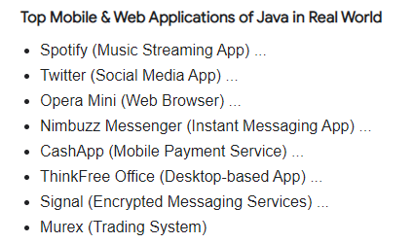
Google & Android OS
NETFLIX ( JAVA & Python)
LinkedIn
Uber
Amazon

Slide 9
Java Platforms / Editions
There are 4 platforms or editions of Java:
1) Java SE (Java Standard Edition)
It is a Java programming platform.
It includes Java programming APIs such as java.lang, java.io, java.net, java.util, java.sql, java.math etc.
It includes core topics like OOPs, String, Regex, Exception, Inner classes, Multithreading, I/O Stream, Networking, AWT, Swing, Reflection, Collection, etc.
2) Java EE (Java Enterprise Edition)
It is an enterprise platform that is mainly used to develop web and enterprise applications.
It is built on top of the Java SE platform. It includes topics like Servlet, JSP, Web Services, EJB, JPA, etc.

Slide 10
Java Platforms / Editions
3) Java ME (Java Micro Edition)
It is a micro platform that is dedicated to mobile applications.
4) JavaFX
It is used to develop rich internet applications. It uses a lightweight user interface API.

Slide 11
History of Java
Java was originally designed for interactive television, initiated this project to develop a language for digital devices such as set-top boxes, televisions, etc.
Currently, Java is used in internet programming, mobile devices, games, e-business solutions, etc.
James Gosling, Mike Sheridan, and Patrick Naughton initiated the Java language project in June 1991.
The small team of sun engineers called Green Team.

Slide 12
History of Java
Why Java was named as "Oak"?
Why Oak? Oak is a symbol of strength and chosen as a national tree of many countries like the U.S.A., France, Germany, Romania, etc.
In 1995, Oak was renamed as "Java" because it was already a trademark by Oak Technologies.
Why Java Programming named "Java"?
Java is an island in Indonesia where the first coffee was produced (called Java coffee). It is a kind of espresso bean. Java name was chosen by James Gosling while having a cup of coffee nearby his office.
Notice that Java is just a name, not an acronym.
Initially developed by James Gosling at Sun Microsystems (which is now a subsidiary of Oracle Corporation) and released in 1995.
JDK 1.0 was released on January 23, 1996. Java Version History

Slide 13
Many java versions have been released till now. The current stable release of Java is Java SE 10.
JDK Alpha and Beta (1995)
JDK 1.0 (23rd Jan 1996)
JDK 1.1 (19th Feb 1997)
J2SE 1.2 (8th Dec 1998)
J2SE 1.3 (8th May 2000)
J2SE 1.4 (6th Feb 2002)
J2SE 5.0 (30th Sep 2004)
Java SE 6 (11th Dec 2006)
Java SE 7 (28th July 2011)
Java SE 8 (18th Mar 2014)
Java SE 9 (21st Sep 2017)
Java SE 10 (20th Mar 2018)
Java SE 11 (September 2018)
Java SE 12 (March 2019)
Java SE 13 (September 2019)
Java SE 14 (Mar 2020)
Java SE 15 (September 2020)
Java SE 16 (Mar 2021)
Java SE 17 (September 2021)
Java SE 18 (to be released by March 2022)

Slide 14
Features of Java
A list of the most important features of the Java language is given below.
Simple
Object-Oriented
Portable
Platform independent
Secured
Robust
Architecture neutral
Interpreted
High Performance
Multithreaded
Distributed
Dynamic

Slide 15
Features of Java
Simple
Java is very easy to learn, and its syntax is simple, clean and easy to understand.
According to Sun Microsystem, Java language is a simple programming language because:
Java syntax is based on C++ (so easier for programmers to learn it after C++).
Java has removed many complicated and rarely-used features, for example, explicit pointers, operator overloading, etc.
There is no need to remove unreferenced objects because there is an Automatic Garbage Collection in Java.

Slide 16
Features of Java
Object-oriented
Java is an object-oriented programming language. Everything in Java is an object.
Object-oriented means we organize our software as a combination of different types of objects that incorporate both data and behavior.
Object-oriented programming (OOPs) is a methodology that simplifies software development and maintenance by providing some rules.
Basic concepts of OOPs are:
Object
Class
Inheritance
Polymorphism
Abstraction
Encapsulation

Slide 17
Platform Independent
Java is platform independent because it is different from other languages like C, C++, etc. which are compiled into platform specific machines while Java is a write once, run anywhere language.
A platform is the hardware or software environment in which a program runs.
There are two types of platforms software-based and hardware-based. Java provides a software-based platform.
The Java platform differs from most other platforms in the sense that it is a software-based platform that runs on top of other hardware-based platforms. It has two components:
Runtime Environment
API(Application Programming Interface)
Java code can be executed on multiple platforms, for example, Windows, Linux, Sun Solaris, Mac/OS, etc.
Java code is compiled by the compiler and converted into bytecode.
This bytecode is a platform-independent code because it can be run on multiple platforms, i.e., Write Once and Run Anywhere (WORA).

Slide 18
Secured
Java is best known for its security. With Java, we can develop virus-free systems. Java is secured because:
No explicit pointer
Java Programs run inside a virtual machine sandbox
Classloader: Class loader in Java is a part of the Java Runtime Environment (JRE) which is used to load Java classes into the Java Virtual Machine dynamically.
It adds security by separating the package for the classes of the local file system from those that are imported from network sources.

Slide 19
Secured
Bytecode Verifier: It checks the code fragments for illegal code that can violate access rights to objects.
Security Manager: It determines what resources a class can access such as reading and writing to the local disk.

Slide 20
Robust
The English mining of Robust is strong. Java is robust because:
It uses strong memory management.
There is a lack of pointers that avoids security problems.
Java provides automatic garbage collection which runs on the Java Virtual Machine to get rid of objects which are not being used by a Java application anymore.
There are exception handling and the type checking mechanism in Java. All these points make Java robust.

Slide 21
Architecture-neutral
Java is architecture neutral because there are no implementation dependent features, for example, the size of primitive types is fixed.
In C programming, int data type occupies 2 bytes of memory for 32-bit architecture and 4 bytes of memory for 64-bit architecture.
However, it occupies 4 bytes of memory for both 32 and 64-bit architectures in Java.

Slide 22
Portable
Java is portable because it facilitates you to carry the Java bytecode to any platform.
It doesn't require any implementation.

Slide 23
High-performance
Java is faster than other traditional interpreted programming languages because Java bytecode is "close" to native code.
It is still a little bit slower than a compiled language (e.g., C++).
Java is an interpreted language that is why it is slower than compiled languages, e.g., C, C++, etc.

Slide 24
Distributed
Java is distributed because it facilitates users to create distributed applications in Java.
RMI and EJB are used for creating distributed applications.
This feature of Java makes us able to access files by calling the methods from any machine on the internet.

Slide 25
Multi-threaded
A thread is like a separate program, executing concurrently.
We can write Java programs that deal with many tasks at once by defining multiple threads.
The main advantage of multi-threading is that it doesn't occupy memory for each thread.
It shares a common memory area.
Threads are important for multi-media, Web applications, etc.

Slide 26
Dynamic
Java is a dynamic language.
It supports the dynamic loading of classes.
It means classes are loaded on demand.
It also supports functions from its native languages, i.e., C and C++.
Java supports dynamic compilation and automatic memory management (garbage collection).

Slide 27
How to set the Temporary Path of JDK in Windows
To set the temporary path of JDK, you need to follow the following steps:
Open the command prompt
Copy the path of the JDK/bin directory
Write in command prompt: set path=copied_path
For Example:
set path=C:\Program Files\Java\jdk1.6.0_23\bin

Slide 28
How to set Permanent Path of JDK in Windows
For setting the permanent path of JDK, you need to follow these steps:
Go to MyComputer properties -> advanced tab -> environment variables -> new tab of user variable -> write path in variable name -> write path of bin folder in variable value -> ok -> ok -> ok

Slide 29
Setting Java Path in Linux OS
Setting path in Linux OS is the same as setting the path in the Windows OS. But, here we use the export tool rather than set.
Let's see how to set path in Linux OS:
export PATH=$PATH:/home/jdk1.6.01/bin/
Here, we have installed the JDK in the home directory under Root (/home).

Slide 30
JVM
JVM (Java Virtual Machine) is an abstract machine.
It is called a virtual machine because it doesn't physically exist. It is a specification that provides a runtime environment in which Java bytecode can be executed.
It can also run those programs which are written in other languages and compiled to Java bytecode.
JVMs are available for many hardware and software platforms There are three notions of the JVM: specification, implementation, and instance.

Slide 31
JRE
JRE is an acronym for Java Runtime Environment. It is also written as Java RTE.
The Java Runtime Environment is a set of software tools which are used for developing Java applications.
It is used to provide the runtime environment.
It is the implementation of JVM.
It physically exists. It contains a set of libraries + other files that JVM uses at runtime.
The implementation of JVM is also actively released by other companies besides Sun Micro Systems.

Slide 32
JDK
JDK is an acronym for Java Development Kit.
The Java Development Kit (JDK) is a software development environment which is used to develop Java applications and applets
.
It contains JRE + development tools.
JDK is an implementation of any one of the below given Java Platforms released by Oracle Corporation:
Standard Edition Java Platform
Enterprise Edition Java Platform
Micro Edition Java Platform
The JDK contains a private Java Virtual Machine (JVM) and a few other resources such as an interpreter/loader (java), a compiler (javac), an archiver (jar), a documentation generator (Javadoc), etc. to complete the development of a Java Application.

Slide 33
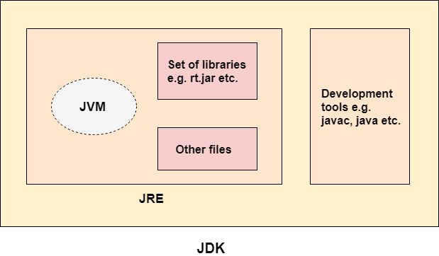

Slide 34
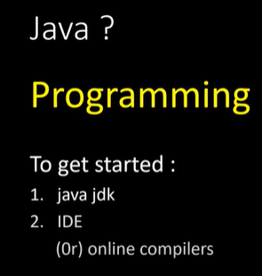
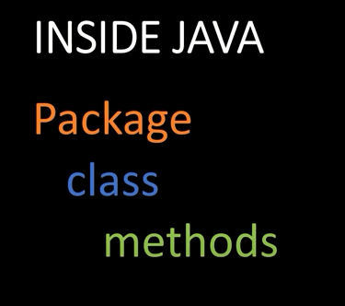

Slide 35
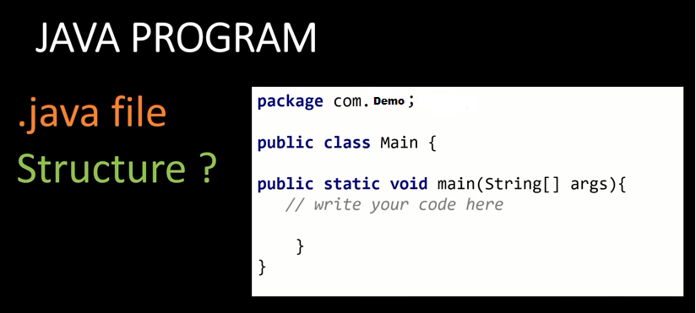

Slide 36
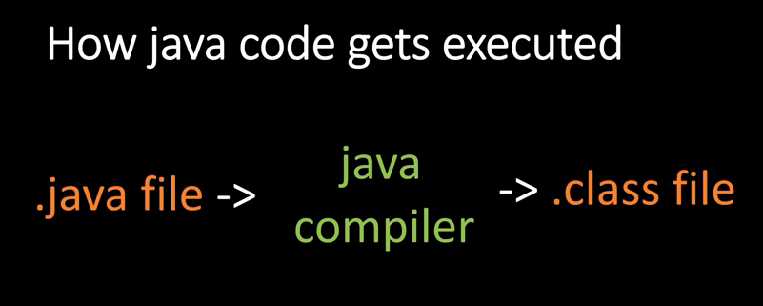

Slide 37
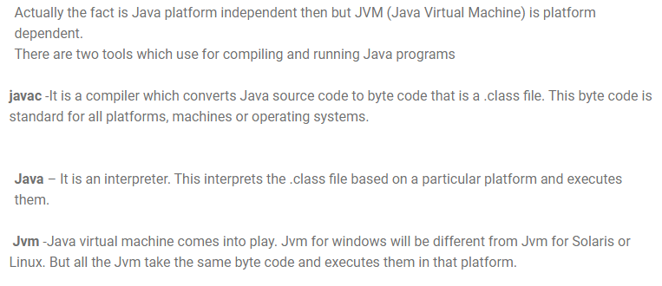

Slide 38
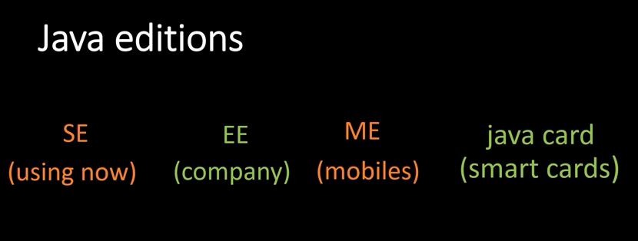

Slide 39
Data Types in Java
Data types specify the different sizes and values that can be stored in the variable. There are two types of data types in Java:
Primitive data types: The primitive data types include boolean, char, byte, short, int, long, float and double.
Non-primitive data types: The non-primitive data types include Classes

Slide 40
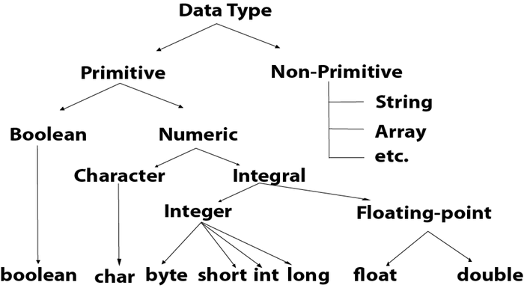
Data Types in Java

Slide 41
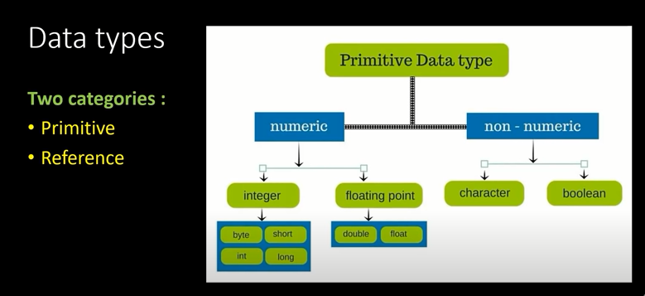
Data Types in Java

Slide 42
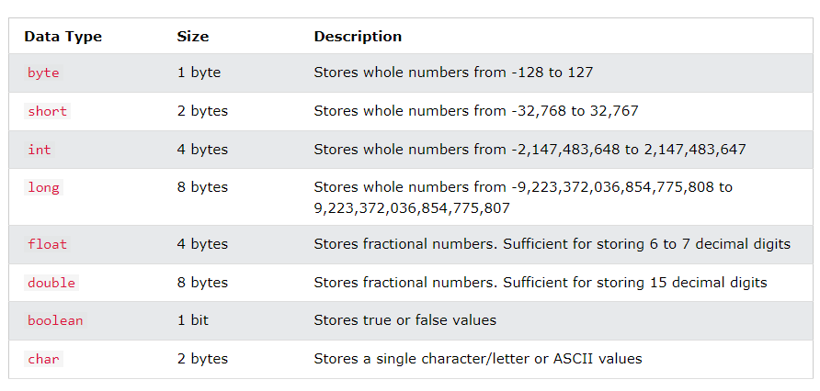
Data Types in Java

Slide 43
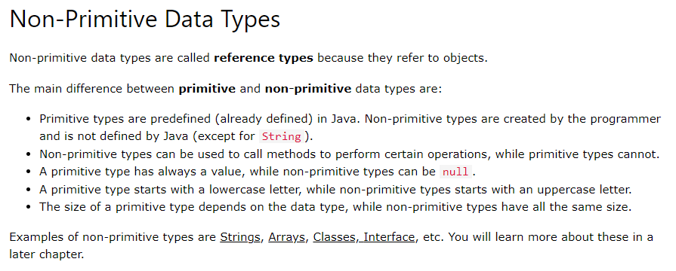
Data Types in Java

Slide 44
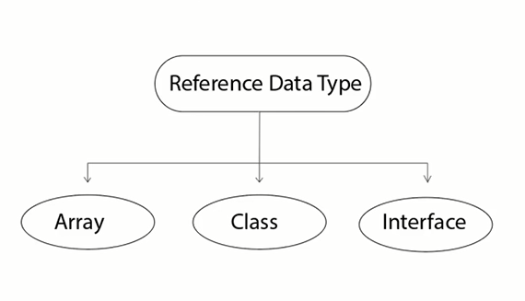
Data Types in Java

Slide 45
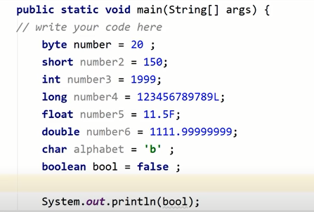
Data Types in Java

Slide 46
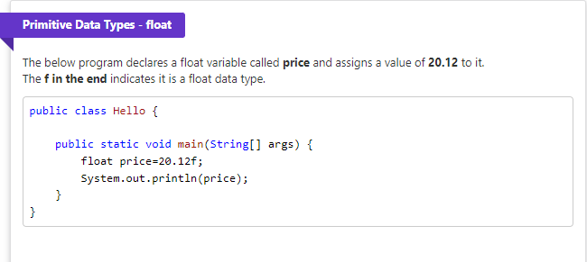
Data Types in Java

Slide 47
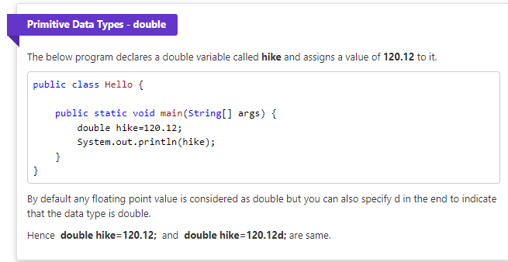
Data Types in Java

Slide 48
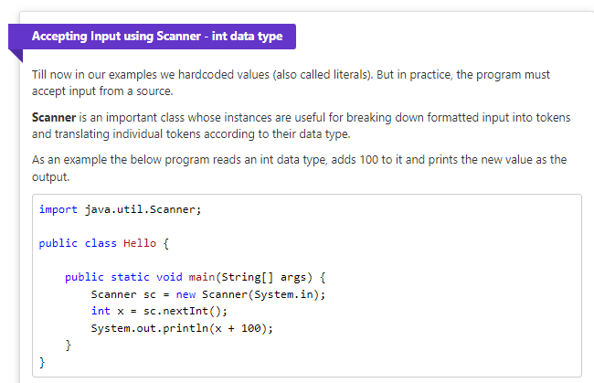
Data Types in Java

Slide 49
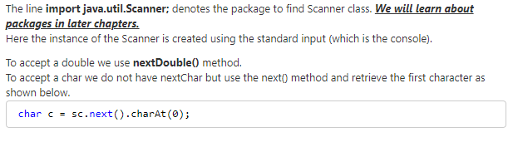
Data Types in Java

Slide 50
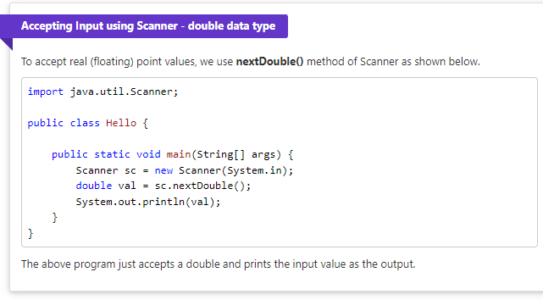
Data Types in Java

Slide 51
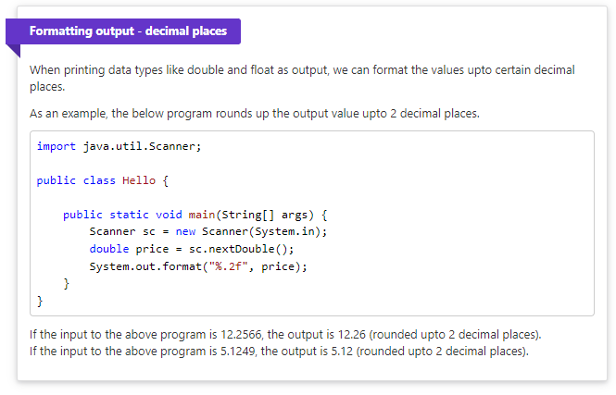
Data Types in Java

Slide 52
Variables
- double: for floating-point or real numbers with optional decimal points and fractional parts in fixed or scientific notations, such as 3.1416, -55.66. - String: for texts such as "Hello" or "Good Morning!". Text strings are enclosed within double quotes. You can declare a variable of a type and assign it a value. Example: String name = "David";
JAVA
This creates a variable called name of type String, and assigns it the value "David".

Slide 53
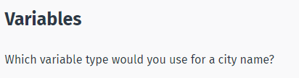
Integer
Float
String

Slide 54
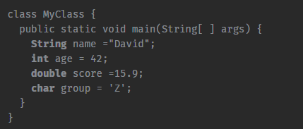
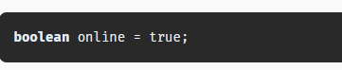
Variables
Examples of variable declarations:
char stands for character and holds a single character.
Another type is the Boolean type, which has only two possible values: true and false.
This data type is used for simple flags that track true/false conditions. For example:

Slide 55
Variables
Variables store data for processing.
A variable is given a name (or identifier), such as area, age, height, and the like.
The name uniquely identifies each variable, assigning a value to the variable and retrieving the value stored.
Variables have types. Some examples:
- int: for integers (whole numbers) such as 123 and -456

Slide 56
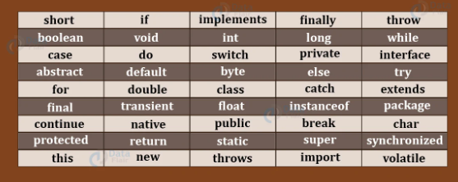
Java Keywords
Java keywords are also known as reserved words.
Keywords are particular words that act as a key to a code.
These are predefined words by Java so they cannot be used as a variable or object name or class name.

Slide 57
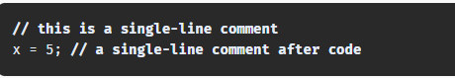
Comments
The purpose of including comments in your code is to explain what the code is doing. Java supports both single and multi-line comments. All characters that appear within a comment are ignored by the Java compiler. A single-line comment starts with two forward slashes and continues until it reaches the end of the line. For example:

Slide 58
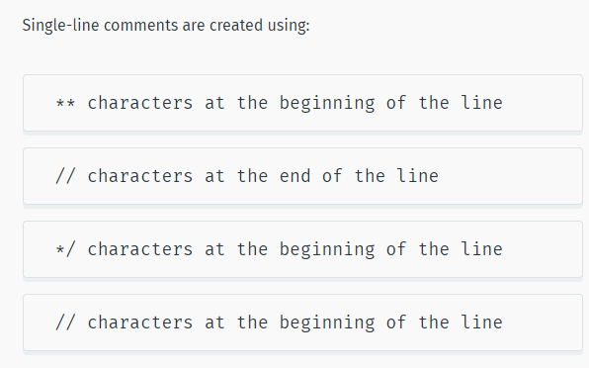

Slide 60
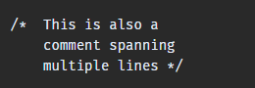
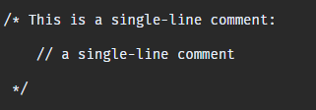
Multi-Line Comments
Java also supports comments that span multiple lines. You start this type of comment with a forward slash followed by an asterisk, and end it with an asterisk followed by a forward slash. For example:
Note that Java does not support nested multi-line comments. However, you can nest single-line comments within multi-line comments.

Slide 61
Multi-Line Comments
Java also supports comments that span multiple lines. You start this type of comment with a forward slash followed by an asterisk, and end it with an asterisk followed by a forward slash. For example:
Note that Java does not support nested multi-line comments. However, you can nest single-line comments within multi-line comments.

Slide 62
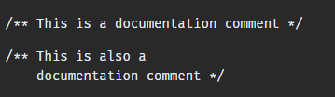
Documentation Comments
Documentation comments are special comments that have the appearance of multi-line comments, with the difference being that they generate external documentation of your source code.
These begin with a forward slash followed by two asterisks, and end with an asterisk followed by a forward slash. For example:

Slide 63
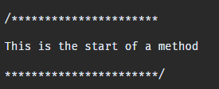
Javadoc is a tool which comes with JDK and it is used for generating Java code documentation in HTML format from Java source code which has required documentation in a predefined format. When a documentation comment begins with more than two asterisks, Javadoc assumes that you want to create a "box" around the comment in the source code. It simply ignores the extra asterisks. For example:

Slide 64
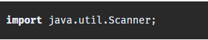

Getting User Input
While Java provides many different methods for getting user input, the Scanner object is the most common, and perhaps the easiest to implement.
Import the Scanner class to use the Scanner object, as seen here:
In order to use the Scanner class, create an instance of the class by using the following syntax:

Slide 65
You can now read in different kinds of input data that the user enters. Here are some methods that are available through the Scanner class: Read a byte - nextByte() Read a short - nextShort() Read an int - nextInt() Read a long - nextLong() Read a float - nextFloat() Read a double - nextDouble() Read a boolean - nextBoolean() Read a complete line - nextLine() Read a word - next()

Slide 66
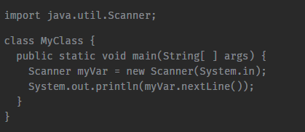
Example of a program used to get user input:

Slide 67
Primitive Operators

Slide 68
Operators in Java
Operator in Java is a symbol that is used to perform operations. For example: +, -, *, / etc.
There are many types of operators in Java which are given below:
Unary Operator,
Arithmetic Operator,
Shift Operator,
Relational Operator,
Bitwise Operator,
Logical Operator,
Ternary Operator and
Assignment Operator.

Slide 69
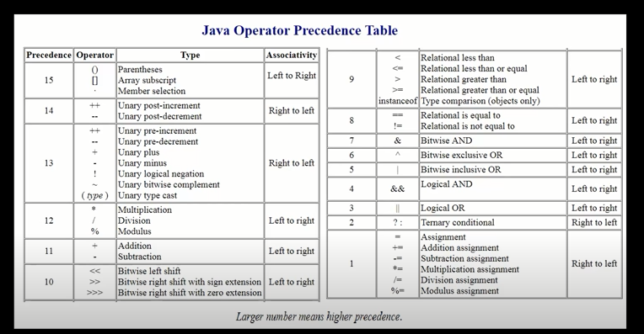
Java Operator Precedence

Slide 70
Java Operator Precedence
Operator Type | Category | Precedence
Unary | postfix | expr++ expr--
 | prefix | ++expr --expr +expr -expr ~ !
Arithmetic | multiplicative | * / %
 | additive | + -
Shift | shift | << >> >>>
Relational | comparison | < > <= >= instanceof
 | equality | == !=
Bitwise | bitwise AND | &
 | bitwise exclusive OR | ^
 | bitwise inclusive OR | |
Logical | logical AND | &&
 | logical OR | ||
Ternary | ternary | ? :
Assignment | assignment | = += -= *= /= %= &= ^= |= <<= >>= >>>=

Slide 71
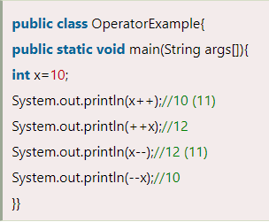
Java Unary Operator
The Java unary operators require only one operand. Unary operators are used to perform various operations i.e.:
incrementing/decrementing a value by one
negating an expression
inverting the value of a boolean

Slide 72
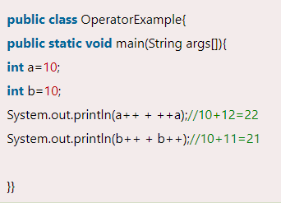
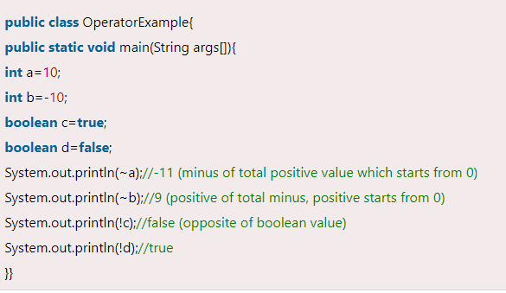

Slide 73
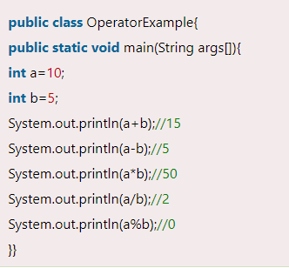
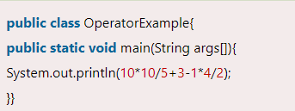
Java Arithmetic Operators
Java arithmetic operators are used to perform addition, subtraction, multiplication, and division. They act as basic mathematical operations.

Slide 74
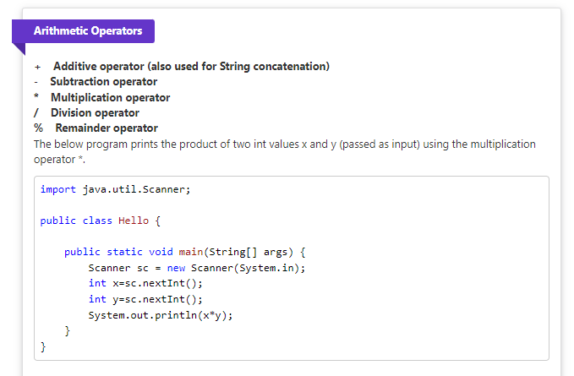
Java Arithmetic Operators

Slide 75
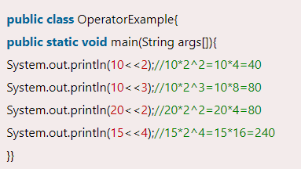
Java Left Shift Operator
The Java left shift operator << is used to shift all of the bits in a value to the left side of a specified number of times.

Slide 76
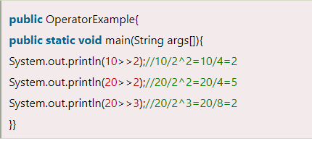
Java Right Shift Operator
The Java right shift operator >> is used to move the value of the left operand to right by the number of bits specified by the right operand.

Slide 77
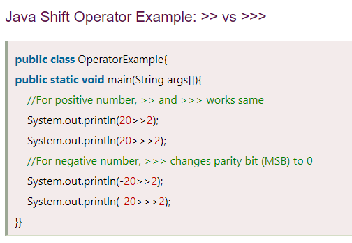

Slide 78
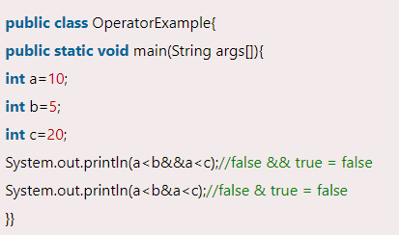
Java AND Operator Example: Logical && and Bitwise &
The logical && operator doesn't check the second condition if the first condition is false. It checks the second condition only if the first one is true.
The bitwise & operator always checks both conditions whether first condition is true or false.

Slide 79
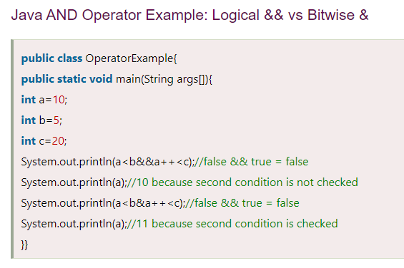

Slide 80
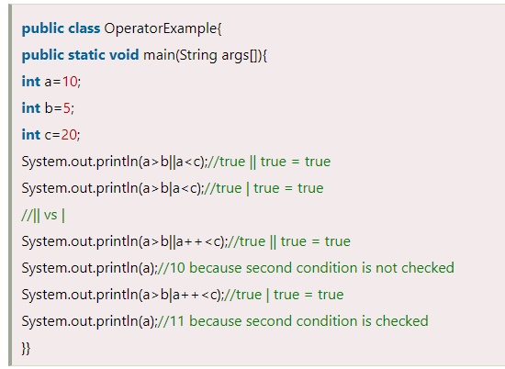
Java OR Operator Example: Logical || and Bitwise |
The logical || operator doesn't check the second condition if the first condition is true. It checks the second condition only if the first one is false.
The bitwise | operator always checks both conditions whether first condition is true or false.

Slide 81
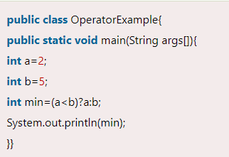
Java Ternary Operator
Java Ternary operator is used as one line replacement for if-then-else statement and used a lot in Java programming. It is the only conditional operator which takes three operands.

Slide 82
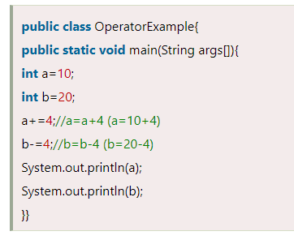
Java Assignment Operator
Java assignment operator is one of the most common operators. It is used to assign the value on its right to the operand on its left.

Slide 83
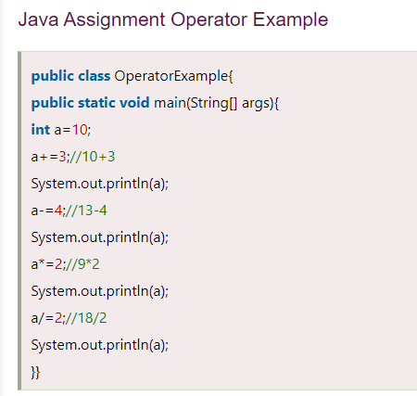

Slide 84
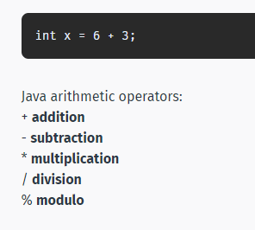
The Math Operators
Java provides a rich set of operators to use in manipulating variables. A value used on either side of an operator is called an operand. For example, in the expression below, the numbers 6 and 3 are operands of the plus operator:

Slide 85
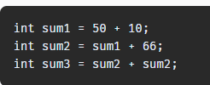

Addition
The + operator adds together two values, such as two constants, a constant and a variable, or a variable and a variable. Here are a few examples of addition:
Subtraction
The - operator subtracts one value from another.

Slide 86
Addition
The + operator adds together two values, such as two constants, a constant and a variable, or a variable and a variable. Here are a few examples of addition:
Subtraction
The - operator subtracts one value from another.

Slide 87



Slide 89

Modulo
The modulo (or remainder) math operation performs an integer division of one value by another, and returns the remainder of that division. The operator for the modulo operation is the percentage (%) character.
Examples

Slide 90


Increment Operators
An increment or decrement operator provides a more convenient and compact way to increase or decrease the value of a variable by one. For example, the statement x=x+1; can be simplified to ++x; Example:
The decrement operator (--) is used to decrease the value of a variable by one.

Slide 91
Increment Operators
An increment or decrement operator provides a more convenient and compact way to increase or decrease the value of a variable by one. For example, the statement x=x+1; can be simplified to ++x; Example:
The decrement operator (--) is used to decrease the value of a variable by one.

Slide 92

Prefix & Postfix
Two forms, prefix and postfix, may be used with both the increment and decrement operators.
With prefix form, the operator appears before the operand, while in postfix form, the operator appears after the operand.
Below is an explanation of how the two forms work: Prefix: Increments the variable's value and uses the new value in the expression. Example:

Slide 93

The value of x is first incremented to 35, and is then assigned to y, so the values of both x and y are now 35. Postfix: The variable's value is first used in the expression and is then increased. Example:
x is first assigned to y, and is then incremented by one. Therefore, x becomes 35, while y is assigned the value of 34.

Slide 94


Assignment Operators
You are already familiar with the assignment operator (=), which assigns a value to a variable.
This assigned the value 5 to a variable called value of type int. Java provides a number of assignment operators to make it easier to write code. Addition and assignment (+=):

Slide 95


Slide 96
Java Control Statements

Slide 97
Java Control Statements | Control Flow in Java
Java compiler executes the code from top to bottom.
The statements in the code are executed according to the order in which they appear.
However, Java provides statements that can be used to control the flow of Java code. Such statements are called control flow statements.
It is one of the fundamental features of Java, which provides a smooth flow of program.
Java provides three types of control flow statements.
Decision Making statements
if statements
switch statement
Loop statements
do while loop
while loop
for loop
for-each loop
Jump statements
break statement
continue statement

Slide 98
Java if Statement
The Java if statement is used to test the condition.
It checks boolean condition: true or false.
There are various types of if statement in Java.
if statement
if-else statement
if-else-if ladder
nested if statement

Slide 99


Java if Statement
The Java if statement tests the condition. It executes the if block if condition is true.
Syntax:
if(condition){
//code to be executed
}

Slide 100

Java if-else Statement
The Java if-else statement also tests the condition. It executes the if block if condition is true otherwise else block is executed.
Syntax:
if(condition){
//code if condition is true
}else{
//code if condition is false }

Slide 101
Java if-else-if ladder Statement
The if-else-if ladder statement executes one condition from multiple statements.
Syntax:
if(condition1){
//code to be executed if condition1 is true
}else if(condition2){
//code to be executed if condition2 is true
}
else if(condition3){
//code to be executed if condition3 is true
}
...
else{
//code to be executed if all the conditions are false
}

Slide 102

Java if-else-if ladder Statement

Slide 103
Java if-else-if ladder Statement
public class IfElseIfExample {
public static void main(String[] args) {
int marks=65;
if(marks<50){
System.out.println("fail");
}
else if(marks>=50 && marks<60){
System.out.println("D grade");
}
else if(marks>=60 && marks<70){
System.out.println("C grade");
}
else if(marks>=70 && marks<80){
System.out.println("B grade");
}
else if(marks>=80 && marks<90){
System.out.println("A grade");
}else if(marks>=90 && marks<100){
System.out.println("A+ grade");
}else{
System.out.println("Invalid!");
}
}
}

Slide 104

Java Nested if statement
The nested if statement represents the if block within another if block. Here, the inner if block condition executes only when outer if block condition is true.
Syntax:
if(condition){
//code to be executed
if(condition){
//code to be executed
}
}

Slide 105
Java Nested if statement
//Java Program to demonstrate the use of Nested If Statement.
public class JavaNestedIfExample {
public static void main(String[] args) {
//Creating two variables for age and weight
int age=20;
int weight=80;
//applying condition on age and weight
if(age>=18){
if(weight>50){
System.out.println("You are eligible to donate blood");
}
}
}}

Slide 106
Java Switch Statement
The Java switch statement executes one statement from multiple conditions. It is like if-else-if ladder statement.
There can be one or N number of case values for a switch expression.
The case value must be of switch expression type only. The case value must be literal or constant. It doesn't allow variables.
The case values must be unique. In case of duplicate value, it renders compile-time error.
The Java switch expression must be of byte, short, int, long (with its Wrapper type), enums and string.
Each case statement can have a break statement which is optional. When control reaches to the break statement, it jumps the control after the switch expression. If a break statement is not found, it executes the next case.
The case value can have a default label which is optional.

Slide 107

Java Switch Statement
Syntax:
switch(expression){
case value1:
//code to be executed;
break;
case value2:
//code to be executed;
break;
......
default:
code to be executed if all cases are not matched;
}

Slide 108
Java Switch Statement
public class SwitchExample {
public static void main(String[] args) {
//Declaring a variable for switch expression
int number=20;
//Switch expression
switch(number){
//Case statements
case 10: System.out.println("10");
break;
case 20: System.out.println("20");
break;
case 30: System.out.println("30");
break;
//Default case statement
default:System.out.println("Not in 10, 20 or 30");
}
}
}

Slide 109
Loops in Java

Slide 110

Java Loops:
The Java for loop is used to iterate a part of the program several times.
If the number of iteration is fixed, it is recommended to use for loop.
There are three types of for loops in Java.

Slide 111

Java While Loop
The Java while loop is used to iterate a part of the program repeatedly until the specified Boolean condition is true.
As soon as the Boolean condition becomes false, the loop automatically stops.
The while loop is considered as a repeating if statement.
If the number of iteration is not fixed, it is recommended to use the while loop.
Syntax:
while (condition){
//code to be executed
Increment / decrement statement
}

Slide 112
Java While Loop
public class WhileExample {
public static void main(String[] args) {
int i=1;
while(i<=10){
System.out.println(i);
i++;
}
}
}

Slide 113
do-while loop
The Java do-while loop is used to iterate a part of the program repeatedly, until the specified condition is true.
If the number of iteration is not fixed and you must have to execute the loop at least once, it is recommended to use a do-while loop.
Java do-while loop is called an exit control loop. Therefore, unlike while loop and for loop, the do-while check the condition at the end of loop body.
The Java do-while loop is executed at least once because condition is checked after loop body.
Syntax:
do{
//code to be executed / loop body
//update statement
}while (condition);

Slide 114

do-while loop
public class DoWhileExample {
public static void main(String[] args)
{
int i=1;
do{
System.out.println(i);
i++;
}while(i<=10);
}
}

Slide 115
Java Simple for Loop
A simple for loop is the same as C/C++. We can initialize the variable, check condition and increment/decrement value. It consists of four parts:
Initialization: It is the initial condition which is executed once when the loop starts. Here, we can initialize the variable, or we can use an already initialized variable. It is an optional condition.
Condition: It is the second condition which is executed each time to test the condition of the loop. It continues execution until the condition is false. It must return boolean value either true or false. It is an optional condition.

Slide 116
Java Simple for Loop
Increment/Decrement: It increments or decrements the variable value. It is an optional condition.
Statement: The statement of the loop is executed each time until the second condition is false.
Syntax:
for(initialization; condition; increment/decrement){
//statement or code to be executed }

Slide 117

//Java Program to demonstrate the example of for loop
//which prints table of 1
public class ForExample {
public static void main(String[] args)
{
//Code of Java for loop
for(int i=1;i<=10;i++){
System.out.println(i);
}
}
}

Slide 118


public class PyramidExample {
public static void main(String[] args) {
for(int i=1;i<=5;i++){
for(int j=1;j<=i;j++){
System.out.print("* ");
}
System.out.println();//new line
}
}
}
public class PyramidExample2 {
public static void main(String[] args) {
int term=6;
for(int i=1;i<=term;i++){
for(int j=term;j>=i;j--){
System.out.print("* ");
}
System.out.println();//new line
}
}
}

Slide 119
for-each Loop
The for-each loop is used to traverse array or collection in Java. It is easier to use than simple for loop because we don't need to increment value and use subscript notation.
It works on the basis of elements and not the index. It returns element one by one in the defined variable.
Syntax:
for(data_type variable : array_name){
//code to be executed
}

Slide 120

//Java For-each loop example which prints the
//elements of the array
public class ForEachExample
{
public static void main(String[] args)
{
//Declaring an array
int arr[]={12,23,44,56,78};
//Printing array using for-each loop
for(int i:arr){
System.out.println(i);
}
}
}

Slide 121
Java Break Statement
When a break statement is encountered inside a loop, the loop is immediately terminated and the program control resumes at the next statement following the loop.
The Java break statement is used to break loop or switch statement. It breaks the current flow of the program at specified condition. In case of inner loop, it breaks only inner loop.
We can use Java break statement in all types of loops such as for loop, while loop and do-while loop.
Syntax:
jump-statement;
break;

Slide 122

Java Break Statement
public class BreakExample {
public static void main(String[] args) {
//using for loop
for(int i=1;i<=10;i++){
if(i==5){
//breaking the loop
break;
}
System.out.println(i);
}
}
}

Slide 123
Continue Statement
The continue statement is used in loop control structure when you need to jump to the next iteration of the loop immediately. It can be used with for loop or while loop.
The Java continue statement is used to continue the loop. It continues the current flow of the program and skips the remaining code at the specified condition. In case of an inner loop, it continues the inner loop only.
We can use Java continue statement in all types of loops such as for loop, while loop and do-while loop.
Syntax:
jump-statement;
continue;

Slide 124

public class ContinueExample {
public static void main(String[] args) {
//for loop
for(int i=1;i<=10;i++){
if(i==5){
//using continue statement
continue;//it will skip the rest statement
}
System.out.println(i);
}
}
}

Slide 125


Strings
A String is an object that represents a sequence of characters. For example, "Hello" is a string of 5 characters. For example:

Slide 126


String Concatenation
The + (plus) operator between strings adds them together to make a new string. This process is called concatenation. The resulted string is the first string put together with the second string. For example:

Slide 127

Decision Making
Conditional statements are used to perform different actions based on different conditions. The if statement is one of the most frequently used conditional statements. If the if statement's condition expression evaluates to true, the block of code inside the if statement is executed. If the expression is found to be false, the first set of code after the end of the if statement (after the closing curly brace) is executed. Syntax:

Slide 128
String Concatenation
The + (plus) operator between strings adds them together to make a new string. This process is called concatenation. The resulted string is the first string put together with the second string. For example:

Slide 129


Any of the following comparison operators may be used to form the condition: < less than > greater than != not equal to == equal to <= less than or equal to >= greater than or equal to For example:

Slide 130


if...else Statements
An if statement can be followed by an optional else statement, which executes when the condition evaluates to false. For example:

Slide 131


Nested if Statements
You can use one if-else statement inside another if or else statement. For example:

Slide 132


else if Statements
Instead of using nested if-else statements, you can use the else if statement to check multiple conditions. For example:
The code will check the condition to evaluate to true and execute the statements inside that block.

Slide 133

Logical Operators
Logical operators are used to combine multiple conditions. Let's say you wanted your program to output "Welcome!" only when the variable age is greater than 18 and the variable money is greater than 500. One way to accomplish this is to use nested if statements:

Slide 134


Logical Operators
However, using the AND logical operator (&&) is a better way:

Slide 135

Logical Operators
The OR Operator
The OR operator (||) checks if any one of the conditions is true. The condition becomes true, if any one of the operands evaluates to true. For example:

Slide 136


Logical Operators
The OR Operator
The code above will print "Welcome!" if age is greater than 18 or if money is greater than 500. The NOT !) logical operator is used to reverse the logical state of its operand. If a condition is true, the NOT logical operator will make it false. Example:

Slide 137

The switch Statement
A switch statement tests a variable for equality against a list of values. Each value is called a case, and the variable being switched on is checked for each case. Syntax:

Slide 138
The switch Statement
- When the variable being switched on is equal to a case, the statements following that case will execute until a break statement is reached. - When a break statement is reached, the switch terminates, and the flow of control jumps to the next line after the switch statement. - Not every case needs to contain a break. If no break appears, the flow of control will fall through to subsequent cases until a break is reached. The example below tests day against a set of values and prints a corresponding message.

Slide 139


The switch Statement
-

Slide 140


The default Statement
A switch statement can have an optional default case. The default case can be used for performing a task when none of the cases is matched. For example:

Slide 141


The switch Expression
The switch expression allows multiple comma-separated values per case and returns a value for the whole switch-case block. For example:
The switch expression makes the switch-case block much shorter and doesn't use a break statement.

Slide 142

while Loops
A loop statement allows to repeatedly execute a statement or group of statements. A while loop statement repeatedly executes a target statement as long as a given condition is true.
The while loops check for the condition x > 0. If it evaluates to true, it executes the statements within its body. Then it checks for the statement again and repeats.

Slide 143


while Loops
When the expression is tested and the result is false, the loop body is skipped and the first statement after the while loop is executed. Example:

Slide 144

for Loops Another loop structure is the for loop. A for loop allows you to efficiently write a loop that needs to execute a specific number of times. Syntax:
Initialization: Expression executes only once during the beginning of loop Condition: Is evaluated each time the loop iterates. The loop executes the statement repeatedly, until this condition returns false. Increment/Decrement: Executes after each iteration of the loop.

Slide 145

The following example prints the numbers 1 through 5.
This initializes x to the value 1, and repeatedly prints the value of x, until the condition x<=5 becomes false.
On each iteration, the statement x++ is executed, incrementing x by one.

Slide 146

for Loops
You can have any type of condition and any type of increment statements in the for loop. The example below prints only the even values between 0 and 10:

Slide 147

do...while Loops
A do...while loop is similar to a while loop, except that a do...while loop is guaranteed to execute at least one time. Example:

Slide 148


do...while Loops
Notice that the condition appears at the end of the loop, so the statements in the loop execute once before it is tested. Even with a false condition, the code will run once. Example:

Slide 149

Loop Control Statements
The break and continue statements change the loop's execution flow. The break statement terminates the loop and transfers execution to the statement immediately following the loop. Example:

Slide 150


Loop Control Statements
The continue statement causes the loop to skip the remainder of its body and then immediately retest its condition prior to reiterating. In other words, it makes the loop skip to its next iteration. Example:

Slide 151
Loop Control Statements
The continue statement causes the loop to skip the remainder of its body and then immediately retest its condition prior to reiterating. In other words, it makes the loop skip to its next iteration. Example:

Slide 152
ARRAYS

Slide 153


Slide 154


Slide 155


Slide 156


Slide 157


Slide 158


Slide 159


Slide 160


Slide 161


Slide 162


Slide 163


Slide 164


Slide 165


Slide 166

Arrays
An array is a collection of variables of the same type. When you need to store a list of values, such as numbers, you can store them in an array, instead of declaring separate variables for each number. To declare an array, you need to define the type of the elements with square brackets. For example, to declare an array of integers:
The name of the array is arr. The type of elements it will hold is int.

Slide 167

Now, you need to define the array's capacity, or the number of elements it will hold. To accomplish this, use the keyword new
The code above declares an array of 5 integers. In an array, the elements are ordered and each has a specific and constant position, which is called an index. To reference elements in an array, type the name of the array followed by the index position within a pair of square brackets.

Slide 168


Example:
This assigns a value of 42 to the element with 2 as its index.

Slide 169


Initializing Arrays
Java provides a shortcut for instantiating arrays of primitive types and strings. If you already know what values to insert into the array, you can use an array literal. Example of an array literal:
Place the values in a comma-separated list, enclosed in curly braces. The code above automatically initializes an array containing 4 elements, and stores the provided values.

Slide 170


Array Length
You can access the length of an array (the number of elements it stores) via its length property. Example:

Slide 171


Arrays
Now that we know how to set and get array elements, we can calculate the sum of all elements in an array by using loops. The for loop is the most used loop when working with arrays, as we can use the length of the array to determine how many times to run the loop.
In the code above, we declared a variable sum to store the result and assigned it 0. Then we used a for loop to iterate through the array, and added each element's value to the variable.

Slide 172

Enhanced for Loop
The enhanced for loop (sometimes called a "for each" loop) is used to traverse elements in arrays. The advantages are that it eliminates the possibility of bugs and makes the code easier to read.

Slide 173

The enhanced for loop declares a variable of a type compatible with the elements of the array being accessed.
The variable will be available within the for block, and its value will be the same as the current array element. So, on each iteration of the loop, the variable t will be equal to the corresponding element in the array.

Slide 174


Multidimensional Arrays
Multidimensional arrays are array that contain other arrays. The two-dimensional array is the most basic multidimensional array. To create multidimensional arrays, place each array within its own set of curly brackets. Example of a two-dimensional array:
This declares an array with two arrays as its elements. To access an element in the two-dimensional array, provide two indexes, one for the array, and another for the element inside that array. The following example accesses the first element in the second array of sample.

Slide 175


Multidimensional Arrays
You can get and set a multidimensional array's elements using the same pair of square brackets. Example:
The above two-dimensional array contains three arrays. The first array has three elements, the second has a single element and the last of these has three elements.

Slide 176

Java String
In Java, string is basically an object that represents sequence of char values. An array of characters works same as Java string. For example:
Java String class provides a lot of methods to perform operations on strings such as compare(), concat(), equals(), split(), length(), replace(), compareTo(), intern(), substring() etc.

Slide 177

The java.lang.String class implements Serializable, Comparable and CharSequence interfaces.

Slide 178

CharSequence Interface
The CharSequence interface is used to represent the sequence of characters. String, StringBuffer and StringBuilder classes implement it. It means, we can create strings in Java by using these three classes.
The Java String is immutable which means it cannot be changed. Whenever we change any string, a new instance is created. For mutable strings, you can use StringBuffer and StringBuilder classes.

Slide 179
What is String in Java?
Generally, String is a sequence of characters. But in Java, string is an object that represents a sequence of characters.
The java.lang.String class is used to create a string object.
How to create a string object?
There are two ways to create String object:
By string literal
By new keyword

Slide 180



Slide 181
Why Java uses the concept of String literal?
To make Java more memory efficient (because no new objects are created if it exists already in the string constant pool).
2) By new keyword
String s=new String("Welcome");//creates two objects and one reference variable
In such case, JVM will create a new string object in normal (non-pool) heap memory, and the literal "Welcome" will be placed in the string constant pool.
The variable s will refer to the object in a heap (non-pool).

Slide 182


Slide 183

Java String class methods
The java.lang.String class provides many useful methods to perform operations on sequence of char values.

Slide 184

Java String class methods

Slide 185

Java String class methods

Slide 186

Java String class methods

Slide 187
Immutable String in Java
A String is an unavoidable type of variable while writing any application program.
String references are used to store various attributes like username, password, etc.
In Java, String objects are immutable. Immutable simply means unmodifiable or unchangeable.
Once String object is created its data or state can't be changed but a new String object is created.
Let's try to understand the concept of immutability by the example given below:

Slide 188


Immutable String in Java

Slide 189


Immutable String in Java

Slide 190

Java String compare

Slide 191
Java String compare
By Using equals() Method
The String class equals() method compares the original content of the string. It compares values of string for equality.
String class provides the following two methods:
public boolean equals(Object another) compares this string to the specified object.
public boolean equalsIgnoreCase(String another) compares this string to another string, ignoring case.

Slide 192


Java String compare

Slide 193


Java String compare
In the above program, the methods of String class are used. The equals() method returns true if String objects are matching and both strings are of same case. equalsIgnoreCase() returns true regardless of cases of strings.

Slide 194


Java String compare
By Using == operator
The == operator compares references not values.

Slide 195
Java String compare
By Using compareTo() method
The String class compareTo() method compares values lexicographically and returns an integer value that describes if first string is less than, equal to or greater than second string.
Suppose s1 and s2 are two String objects. If:.
s1 == s2 : The method returns 0.
s1 > s2 : The method returns a positive value.
s1 < s2 : The method returns a negative value.

Slide 196


Java String compare

Slide 197
Java String compare

Slide 198


String Concatenation in Java
In Java, String concatenation forms a new String that is the combination of multiple strings. There are two ways to concatenate strings in Java:
By + (String concatenation) operator
By concat() method
String Concatenation by + (String concatenation) operator
Java String concatenation operator (+) is used to add strings. For Example:

Slide 199


String Concatenation in Java
String Concatenation by concat() method
The String concat() method concatenates the specified string to the end of current string. Syntax:
public String concat(String another)
Let's see the example of String concat() method.

Slide 200
String concatenation using StringBuilder class
StringBuilder is class provides append() method to perform concatenation operation.
The append() method accepts arguments of different types like Objects, StringBuilder, int, char, CharSequence, boolean, float, double.
StringBuilder is the most popular and fastet way to concatenate strings in Java.
It is mutable class which means values stored in StringBuilder objects can be updated or changed.

Slide 201



Slide 202


String concatenation using format() method
String.format() method allows to concatenate multiple strings using format specifier like %s followed by the string values or objects.

Slide 203
String concatenation using format() method
String.format() method allows to concatenate multiple strings using format specifier like %s followed by the string values or objects.

Slide 204
Substring in Java
A part of String is called substring.
In other words, substring is a subset of another String. Java String class provides the built-in substring() method that extract a substring from the given string by using the index values passed as an argument.
In case of substring() method startIndex is inclusive and endIndex is exclusive.
You can get substring from the given String object by one of the two methods:
public String substring(int startIndex): This method returns new String object containing the substring of the given string from specified startIndex (inclusive). The method throws an IndexOutOfBoundException when the startIndex is larger than the length of String or less than zero.
public String substring(int startIndex, int endIndex): This method returns new String object containing the substring of the given string from specified startIndex to endIndex. The method throws an IndexOutOfBoundException when the startIndex is less than zero or startIndex is greater than endIndex or endIndex is greater than length of String.

Slide 205


Substring in Java

Slide 206


Java String toUpperCase() and toLowerCase() method
The Java String toUpperCase() method converts this String into uppercase letter and String toLowerCase() method into lowercase letter.

Slide 207


Slide 208


Slide 210


Slide 211


Slide 212
Java StringBuffer Class
Java StringBuffer class is used to create mutable (modifiable) String objects. The StringBuffer class in Java is the same as String class except it is mutable i.e. it can be changed.
Important Constructors of StringBuffer Class
Constructor | Description
StringBuffer() | It creates an empty String buffer with the initial capacity of 16.
StringBuffer(String str) | It creates a String buffer with the specified string..
StringBuffer(int capacity) | It creates an empty String buffer with the specified capacity as length.

Slide 213



Thank You

